Slide 1
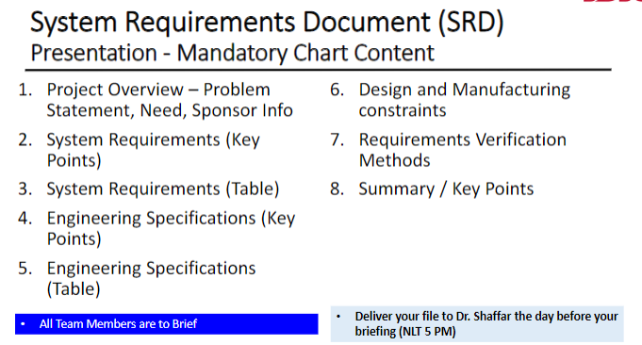

Slide 2


Mechanical Engineering Senior Design (ME490A) Team M9, Mean Green Growing Machine Project 18, Automated Microgreens System Requirements Document 10/12/20
John Berger, Max Merritt, Thuyavan Sathiamurthi, Conor Vasiliadis
Ali Alqaoud, Daniel Kenner, Jose Baez, Abigail Dabu, Elias Wooten

Slide 3
Project Overview
Problem Statement:
There is an increasing demand for microgreens due to the higher concentration of nutrient contents. However, with microgreens being a relatively new industry, consumers can find it difficult to find markets that sell the product. Where microgreens are found, they are usually priced at a premium due to the nutritional content and niche appeal of the product.
Need:
To design and analyze an automated growing environment, which will allow consumers to produce microgreens at home. To accomplish this, we will need to research the microgreen growing process. System functionality will need to be tested and tuned for optimal plant mass output and growth period. The overall design will have to be optimized to be economically viable as a consumer product.
Project Sponsor:
John Berger & ZIP Launchpad

Slide 4
System Requirements - Key Points
Device will produce 6-7 cups of microgreens per week
Device will have an autonomous watering system
Maintain growing area at optimal temperature & humidity
Autonomously controlled light duration and intensity to maximize plant growth
Autonomous nutrient and PH balancing to maximize plant growth
Growth cycles will be initiated via the digital user interface
Aggregate growth data will be continuously available online

Slide 5
System Requirements Table
Requirement Number | Priority Level (1 - 5) | User Requirement | Justification | User Requirement Information Sources
17119000 | 4 | Device must be operational over a large amount of cycles. | 5 years minimum product life before service of parts or replacement is needed. Similar to many consumer products | Sponsor Requirement
17111400 | 5 | Maintain growing area at optimal temperature & Humidity | Greens generally need to be kept at an optimal temperature otherwise they will grow more slowly/perish | Team Requirement https://www.microgreengarden.com/seeds
17112800 | 5 | Device shall have an autonomous watering system. | Automatic watering shall reduce the amount of work from the user | Team Requirement https://www.microgreengarden.com/seeds
17113700 | 5 | Lighting: Controlled light duration and intensity to maximize plant growth. | Automatic lighting shall reduce the amount of work from the user | Team Requirement https://www.microgreengarden.com/seeds
17124300 | 3 | Low Service Time | Reduce customer strain | Sponsor Requirement
17130500 | 3 | Aggregate growth data shall be continuously available online | Users shall be able to monitor the machine remotely | Sponsor Requirement
17138400 | 5 | A bluetooth app will be used for the user interface | Adding a dedicated physical user interface to the machine would add cost & would be less convenient for the user. | Sponsor Requirement

Slide 6
Engineering Specs - Key Points
Product must support a five year life cycle
Growing area will remain between 15°- 28°C at >75% relative humidity
Lighting system will provide >15 Daily Light Integral (DLI)
Scheduled watering frequency and duration to maximize plant growth
Monthly service time will be less than 45 minutes
Data on growth conditions can be accessed from server

Slide 7
Engineering Specifications
Requirement Number | User Requirement | Engineering Specifications | Justification | User Requirement Information Sources
17119000 | Device must be operational over a large amount of cycles. | Five year product lifecycle | 5 years minimum product life before service of parts or replacement is needed. Similar to many consumer products | Sponsor Requirement
17111400 | Maintain growing area at optimal temperature & Humidity | Growing area temperature will remain between 15°- 28°C | Greens generally need to be kept at an optimal temperature otherwise they will grow more slowly/perish | Team Requirement https://www.microgreengarden.com/seeds
 |  | Device will maintain relative humidity >75%
17112800 | Device will have an autonomous watering system. | Scheduled watering frequency and duration to maximize plant growth. | Automatic watering will reduce the amount of work from the user | Team Requirement https://www.microgreengarden.com/seeds
17113700 | Lighting: Controlled light duration and intensity to maximize plant growth. | Lighting system will provide >15 Daily Light Integral (DLI) | Automatic lighting will reduce the amount of work from the user | Team Requirement https://www.microgreengarden.com/seeds
 |  | Lighting quality will maintain the following ratios R87:B10:FR2.5 with 15% adjustability on each wavelength
17124300 | Low service Time | Total time to clean growing trays, flush the lines, and fill with new water shall be less than 45 minutes per month | Reduce customer strain | Sponsor Requirement
17130500 | Aggregate growth data will be continuously available online | Device shall record and store temperature, humidity, and other pertinent conditions in a hard drive on a server to be accessed 24/7 by the user | Users will be able to monitor the machine remotely | Sponsor Requirement
 |  | Data shall be recorded every 10 minutes
 | Bluetooth stuff

Slide 8
Design and Manufacturing Constraints
Design Constraints
Team shall utilize Solidworks, Altium, Rapid Harness to design mechanical and electrical components
Device must be able to grow multiple varieties of microgreens
All subsystems shall be designed to be serviceable
All PCB design shall follow UL796 & UL 60950-1 specifications for circuit trace spacing
Maximum weight of 40kg and be movable by one person
Manufacturing constraints:
Manufacturing shall be limited to the capabilities of either:
Student skill level
Capabilities of Rieker Machine shop or other local machine shops
Circuit boards shall be from JLC PCB as per ECE students request.
Wired connections shall either be soldered or crimped with proper tools
Care will be taken when manufacturing to conserve material
Majority of the device will be manufactured using screws, nuts and bolts in order to aid in disassembly.

Slide 9
Requirements Verification methods
Test
Output micrgreen fresh weight needs to meet 6-7 cups a week goal
The pH of the system will be maintained at 5.5-6 during growth cycles and verified via pH sensor
Growing area temperature will be maintained at 15°- 28°C and verified with a thermometer
System will dynamically adjust environmental conditions based on plant profiles
Analysis
Verify current nutrient concentration is optimal for plant growth with nutrient sensor
Verify watering frequency/amount is optimal for plant growth by comparing fresh weight to empirical data
Plant profiles will be adjusted for optimal growth based on several trials
Device will be reset to show how system will adapt
Demonstration
Water system will be cycled to ensure proper operation of flow
Nutrient/PH solution insertion gives proper concentration based on given inputs
Subsystems will all operate in unison to show proper communication/power draw
Show cleaning time is under maximum allotted amount of time
User interface is able to control plant growth cycle and monitor growing conditions
Fan speed changes based on given inputs
Off switch will pause all subsystems

Slide 10
Summary
The growing machine is required to autonomously produce microgreens of the highest quality at a rate of 6-7 cups per week
Team members are currently in the ideation phase of design
Integrating electrical team members as well as electrical systems into the design
The machine will be created to work reliably and be easy to service
The project will be evaluated to ensure that the systems are operating at optimal growing conditions

